Slide 1
Sales
File created on: 02-Jan-21 2:45:59 PM

Slide 2
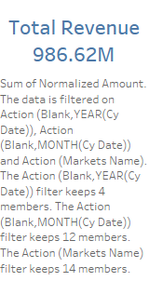

Slide 3
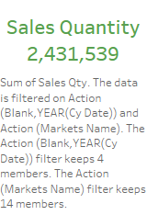

Slide 4
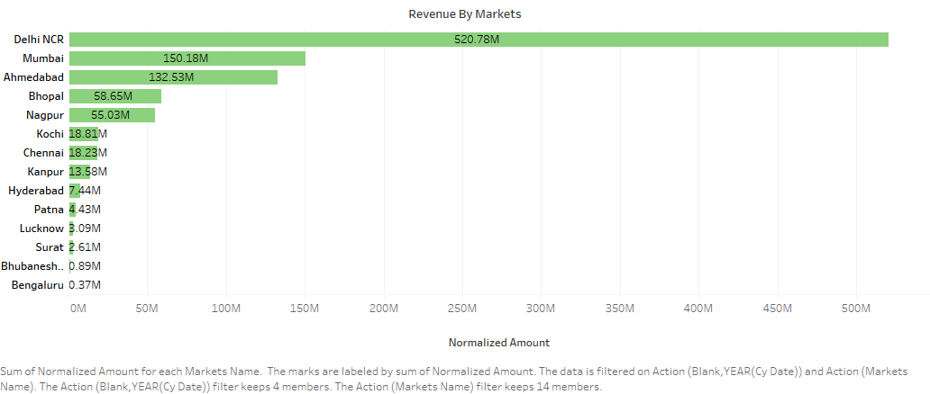

Slide 5
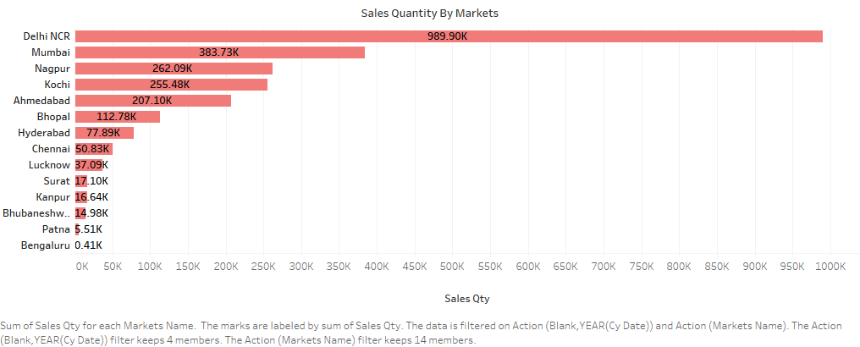

Slide 6


Slide 7


Slide 8
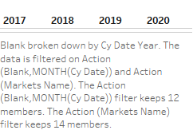

Slide 9


Slide 10
